Slide 1



Slide 2
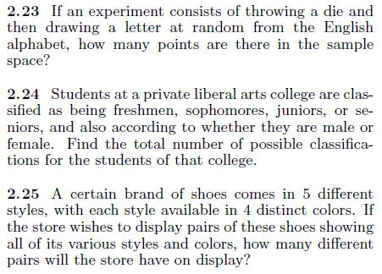



Slide 3
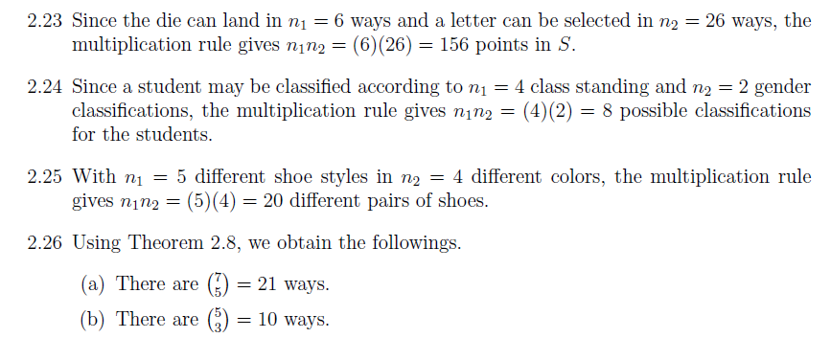
solution
Q 2.27-----Q2.38

Slide 4
Homework
Q 2.27-----Q2.38 pg: 51

Slide 5
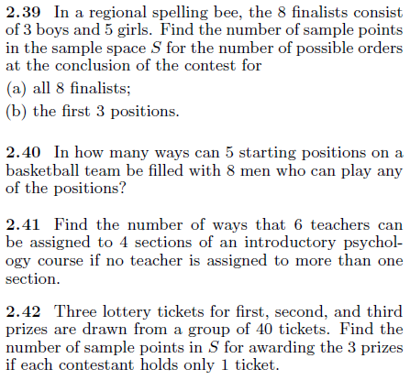

Slide 6


